Slide 1
Using remeasured FIA plots to identify management specific forest carbon flux patterns in Oregon and California
William Stewart, Jeremy Fried, Olaf Kuegler
Western Forest Economists Meeting
Fort Collins, CO
May 31, 2017

Slide 2
The Questions
Do forest management approaches alter forest carbon sequestration rates?
If so, how do they compare?
Can forest-based carbon sequestration be improved?
To date, most of the ‘answers’ have been based on a combination of analysis of satellite imagery, a few plot-based calibrations, and forest growth models
FIA remeasurements of the same trees on the same plots since 2011 provide the most comprehensive data set to answer the questions using basic accounting principles
Notes:
FIA remeasurements provide a more robust sample than small area measurements and models.
There are a number of reasons why forest economists should care about all of these tree demography data.
Unlike sawlogs, owners can get no financial compensation for either their carbon storage or the annual carbon sequestration rate. But there is an endless public policy discussion about whether the private or public entities should have financial incentives or regulatory requirements to provide ‘carbon climate benefits’ – however they will measured. As many of you know, California’s ARB will pay forest owners if they can justify a certain forest condition and promise to keep those above regional average inventories for 100 years. Most of the beneficiaries are now east of the Mississippi.

Slide 3
Oregon - #1 timber producing state in US. Higher site quality in Western OR. State and BLM lands nearer coast, lots of BLM/pvt checkerboard,
Notes:
OR and CA have nearly identical areas of forest, share the same tree species, same endangered birds, fish, and mammals; and the same mix of owners.
OR’s forests have more preferable precipitation and temperature conditions than CA , leading to higher site quality.
Many factors lead to the current status where OR grows about 33% more woody biomass than CA but produces 3x as many wood products as CA from basically the same area of forests. Much of OR’s production is shipped to California – the #1 Wood consuming state in the nation. Every time CA reduces our timber harvest, we make up much of it with imports from OR.

Slide 4
California - #1 timber importing state in the US. 10 mile wide redwood belt on coast has highest productivity, State lands also nearer coast, little BLM lands, USFS/Pvt checkerboard, more park and wilderness lands, and a lot more wildfire.
Notes:
California has a longer forested mountain range and more forests have a fire-friendly Mediterranean climate.

Slide 5
Forest Ownership in ‘000 Acres
Owner | OR | CA
BLM | 3,657 | 1,412
NPS | 133 | 1,301
State | 968 | 690
O Public | 184 | 499
NFS Other | 422 | 1,908
NFS Reserve | 2,592 | 4,113
NFS Timberland | 11,152 | 9,049
Pvt Non-Industry | 3,080 | 6,329
Pvt Industry | 7,591 | 5,948
Total | 29,783 | 31,253
Notes:
Although the total area is roughly the same, there are differences in the distribution across owners. OR has a much bigger BLM presence while CA has considerably more forests in wilderness and parks. We also have a lot more private land owned by families rather than companies – who typically practice less intensive forest management.
The 2008 Farm Bill protects the privacy of private land owners, so the any detailed splits between these two very different types of private forest owners can only be done by USFS researchers.
The Classic comparison NFS Timberland v Private Industry makes up only ½ the acres in each state. Much more ownership and management variation to use

Slide 6
Live Tree Inventories (MgC/ha)
State | Trees | NFS R | NFS T | All | Pvt N Ind | Pvt Ind
OR | LT25” | 62 | 45 | 47 | 38 | 46
OR | GT25” | 45 | 40 | 28 | 9 | 9
OR | ALL | 107 | 85 | 75 | 47 | 56
CA | LT25” | 36 | 46 | 41 | 36 | 48
CA | GT25” | 50 | 48 | 33 | 15 | 21
CA | ALL | 86 | 95 | 74 | 51 | 69
Similar inventories per hectare by ownership in OR and CA
More big trees in CA across all ownerships
~50% of NFS inventories in trees larger than 25”
~20-30% of Private inventories in trees larger than 25”
Notes:
The combination of better sites and higher production in OR results in the inventories per hectare that are remarkably similar to CA.

Slide 7
Photosynthetic carbon capture = Gross Growth + Respiration
Gross Growth = Net Change (G) + Removals ( R) + Mortality (M)
Private Non Industrial Ownerships most closely match State means
Allocation of GRM is very different across ownerships
Notes:
For a comparison, I will show just two federal ownerships, the all state mean, and two private ownerships to represent the range in each state.
You can see from the ‘removals’ in the central bar that OR produces about 3x as much product from the same amount of total forest land as in CA.
Mortality losses are much higher in CA while net change in forest inventories are higher in OR for all ownerships except Private Industry lands.

Slide 8
Gross Growth = Net Change (G) + Removals ( R) + Mortality (M)
Private Non Industrial Ownerships most closely match State means
Allocation of GRM is very different across ownerships

Slide 9
Gross Growth = Net Change (G) + Removals ( R) + Mortality (M)
Private Non Industrial Ownerships most closely match State means
Allocation of GRM is very different across ownerships
Notes:
GRM patterns really diverge for the 25% (pvt) to 50% (NFS) of the total inventory in trees GT 25” . Significant levels of carbon capture, not proportional to initial inventory, but a lot of it goes from live to dead trees – mortality. Harvest is significant of private industry who probably have equal amounts growing in to this size class.

Slide 10
Big Trees: High Respiration Rates but not High Mortality Rates control carbon*climate benefits
Oregon | NFS R | NFS T | All | Pvt NonInd | Pvt Ind
LT25 Gross | 1.9 % | 3.2 % | 3.8 % | 4.5 % | 5.2%
LT25 Mortality | 1.5 % | 1.1 % | 0.9% | 0.6 % | 0.6 %
GT25 Gross | 0.9% | 1.0 % | 1.2 % | 2.8% | 1.9 %
GT25 Mortality | 0.8 % | 0.6 % | 0.5 % | 0.1 % | 0.3 %
California | NFS R | NFS T | All | Pvt NonInd | Pvt Ind
LT25 Gross | 2.1 % | 2.9 % | 3.0 % | 3.0 % | 3.8 %
LT25 Mortality | 1.7 % | 1.3 % | 1.1 % | 0.9 % | 0.8 %
GT25 Gross | 0.8 % | 1.0 % | 1.2 % | 1.9 % | 1.9 %
GT25 Mortality | 1.4 % | 1.1 % | 0.9 % | 0.5 % | 0.4 %
Rates as a percent of initial inventory
Notes:
We are obsessed with big trees in California. It started with the sequoia and redwood groves and dominates the mythology of what ‘fire resistant’ forests of old looked like. From a carbon capture perspective, the big trees in have similar growth rates in OR and CA. However, as a percent of initial inventory, they are not nearly as efficient as small and medium diameter trees. One explanation is that the big trees need to allocate far more of the carbon created by photosynthesis to respiration – leaving less for new wood.
Big tree situation – lots and lots of leaf area, on average 2-3 years old, but the large trees need more and more of energy from photosynthesis for respiration. Just not producing nearly as much gross growth as a percentage of inventory as small and medium sized trees. It is not high mortality levels as much as it is high respiration needs

Slide 11
Fire mortality is high on all NFS lands and much higher in CA
Non-fire mortality is higher across ownerships in CA – due to GT25 trees
Notes:
Another important issue is what are the drivers of mortality rates.
Fire Mortality is the biggest difference across ownerships and across states – Much higher on National Forests and much higher in California
CA has much more non-fire mortality than OR. This dataset only has the beginning of beetle mortality in CA – so it is mainly disease (known or unknown type)
Much more physical mortality in OR – windstorms, suppression, animal damage. – not much to do about those.
CA National Forests have similar inventories of large trees but much more mortality in those size classes.
As a carbon capture strategy , promoting more and more big trees has a lot of fans in California in the state and federal governments, but the data does not support it.

Slide 12
Annual Fire Probability by Area and Inventory
State | Fire Agency | AFP (area) | AFP (inv) | Pct killed in fire perimeter
OR | Federal | 0.50 % | 0.23 % | 46 %
OR | State | 0.16 % | 0.05 % | 30 %
CA | Federal | 1.31 % | 0.48 % | 36 %
CA | State | 0.36 % | 0.13 % | 36 %
Wildfires do not kill all the trees within burn perimeters – 30-50% by type
Wildfires are 2.5x as common in California: Expected
Wildfires are 3x as common on Federal Lands: Less Expected
What is due to fuels ?
What is due to fire suppression strategies ?
What can be done to reduce the area or severity of wildfires?
Notes:
The USFS now allocates more than ½ its total budget to fire suppression.
The fire agency comparison suggests that there may be some lessons to be learned from state fire agencies.
However there is nearly nothing in the academic or policy literature that I could find addressing the fire agency related differences in AFP.

Slide 13
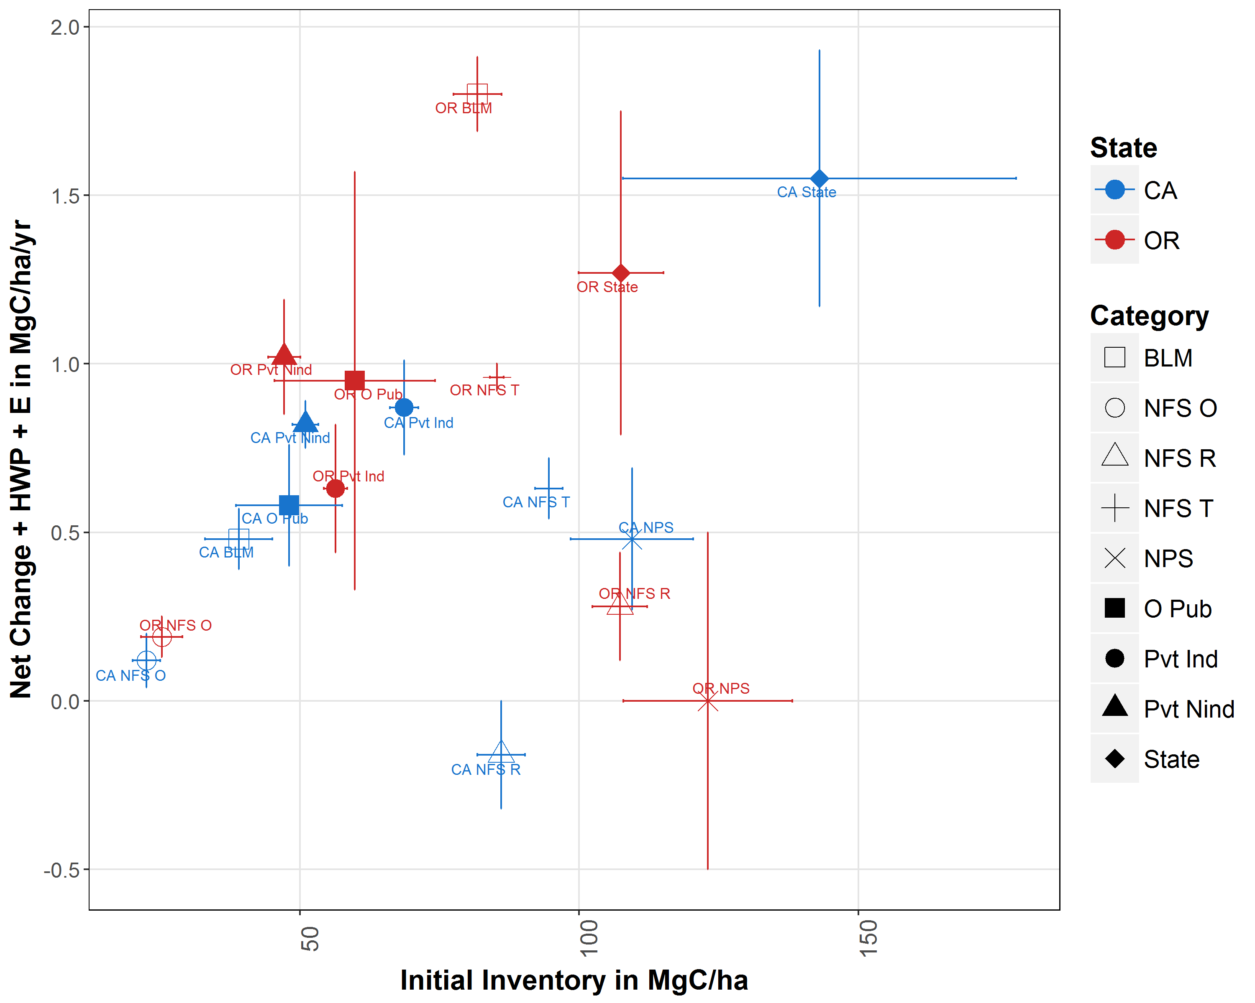
Historic Practices: Use 25% of Removals
Notes:
Finally, I want to conclude by going tack to question #3 - Can forest-based carbon sequestration be improved?
Much of this depends on how efficiently society uses the harvested wood.
A lot is still left in the woods as logging slash, but across OR and CA there are many examples where utilization rates are higher than the historic practices.
There are still areas where only the most valuable sawlog boles are taken out and many climate models assume that only 25% of the cut volume makes it out.
Under those assumptions, this scatterplot shows the means and standard errors by ownership type for OR and CA.
We see the high fliers – public lands in the productive coastal forests of OR and CA. We see the low productive forests with low inventories and low growth rates.
Down the middle, we have the forests with more management with higher sequestration rates but lower inventories to the NW and the less managed federal forests to the SE. With this accounting approach, we have a cluster of similar performers from OR and CA. The most financially productive system – OR Pvt Industry – is less productive on either metric than OR NFS Timberlands.
25% utilization – When only sawlogs are considered benefits, total carbon sequestration rates favor entities that increase live tree inventories. Highly productive coastal forests with relatively low harvest rates – OR BLM, CA State, and OR State lands are real standouts.

Slide 14
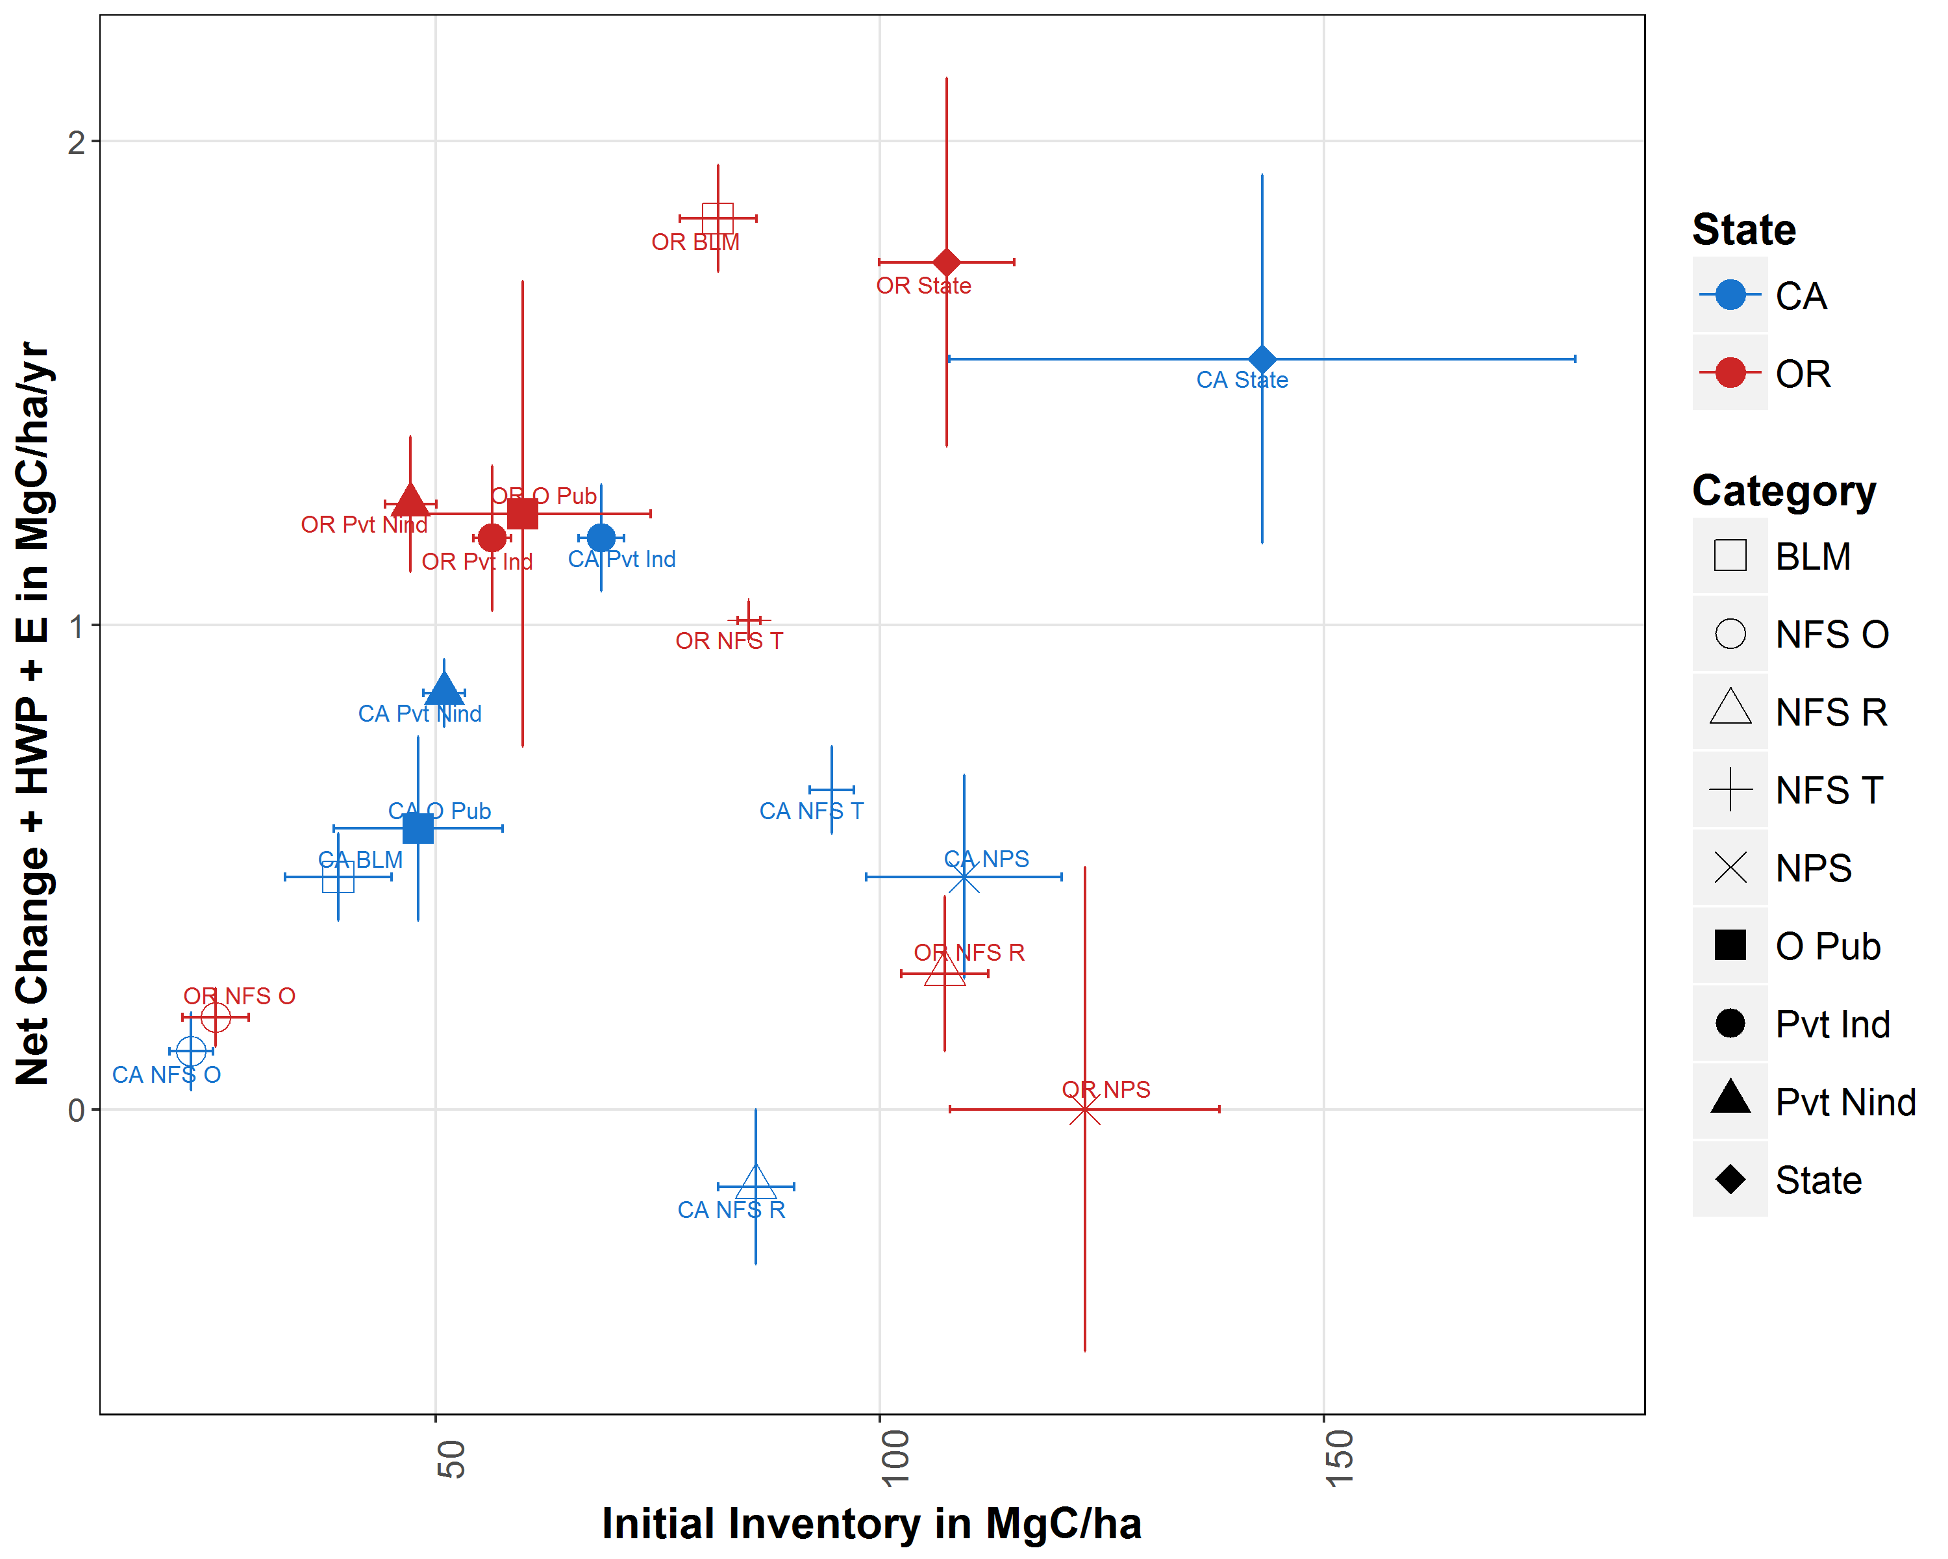
OK Practices: Use 50% of Removals
Notes:
As we start to model what are OK practices, 50% utilization, ownerships with relatively higher harvest rates show an increase in total carbon sequestration rate metric.

Slide 15
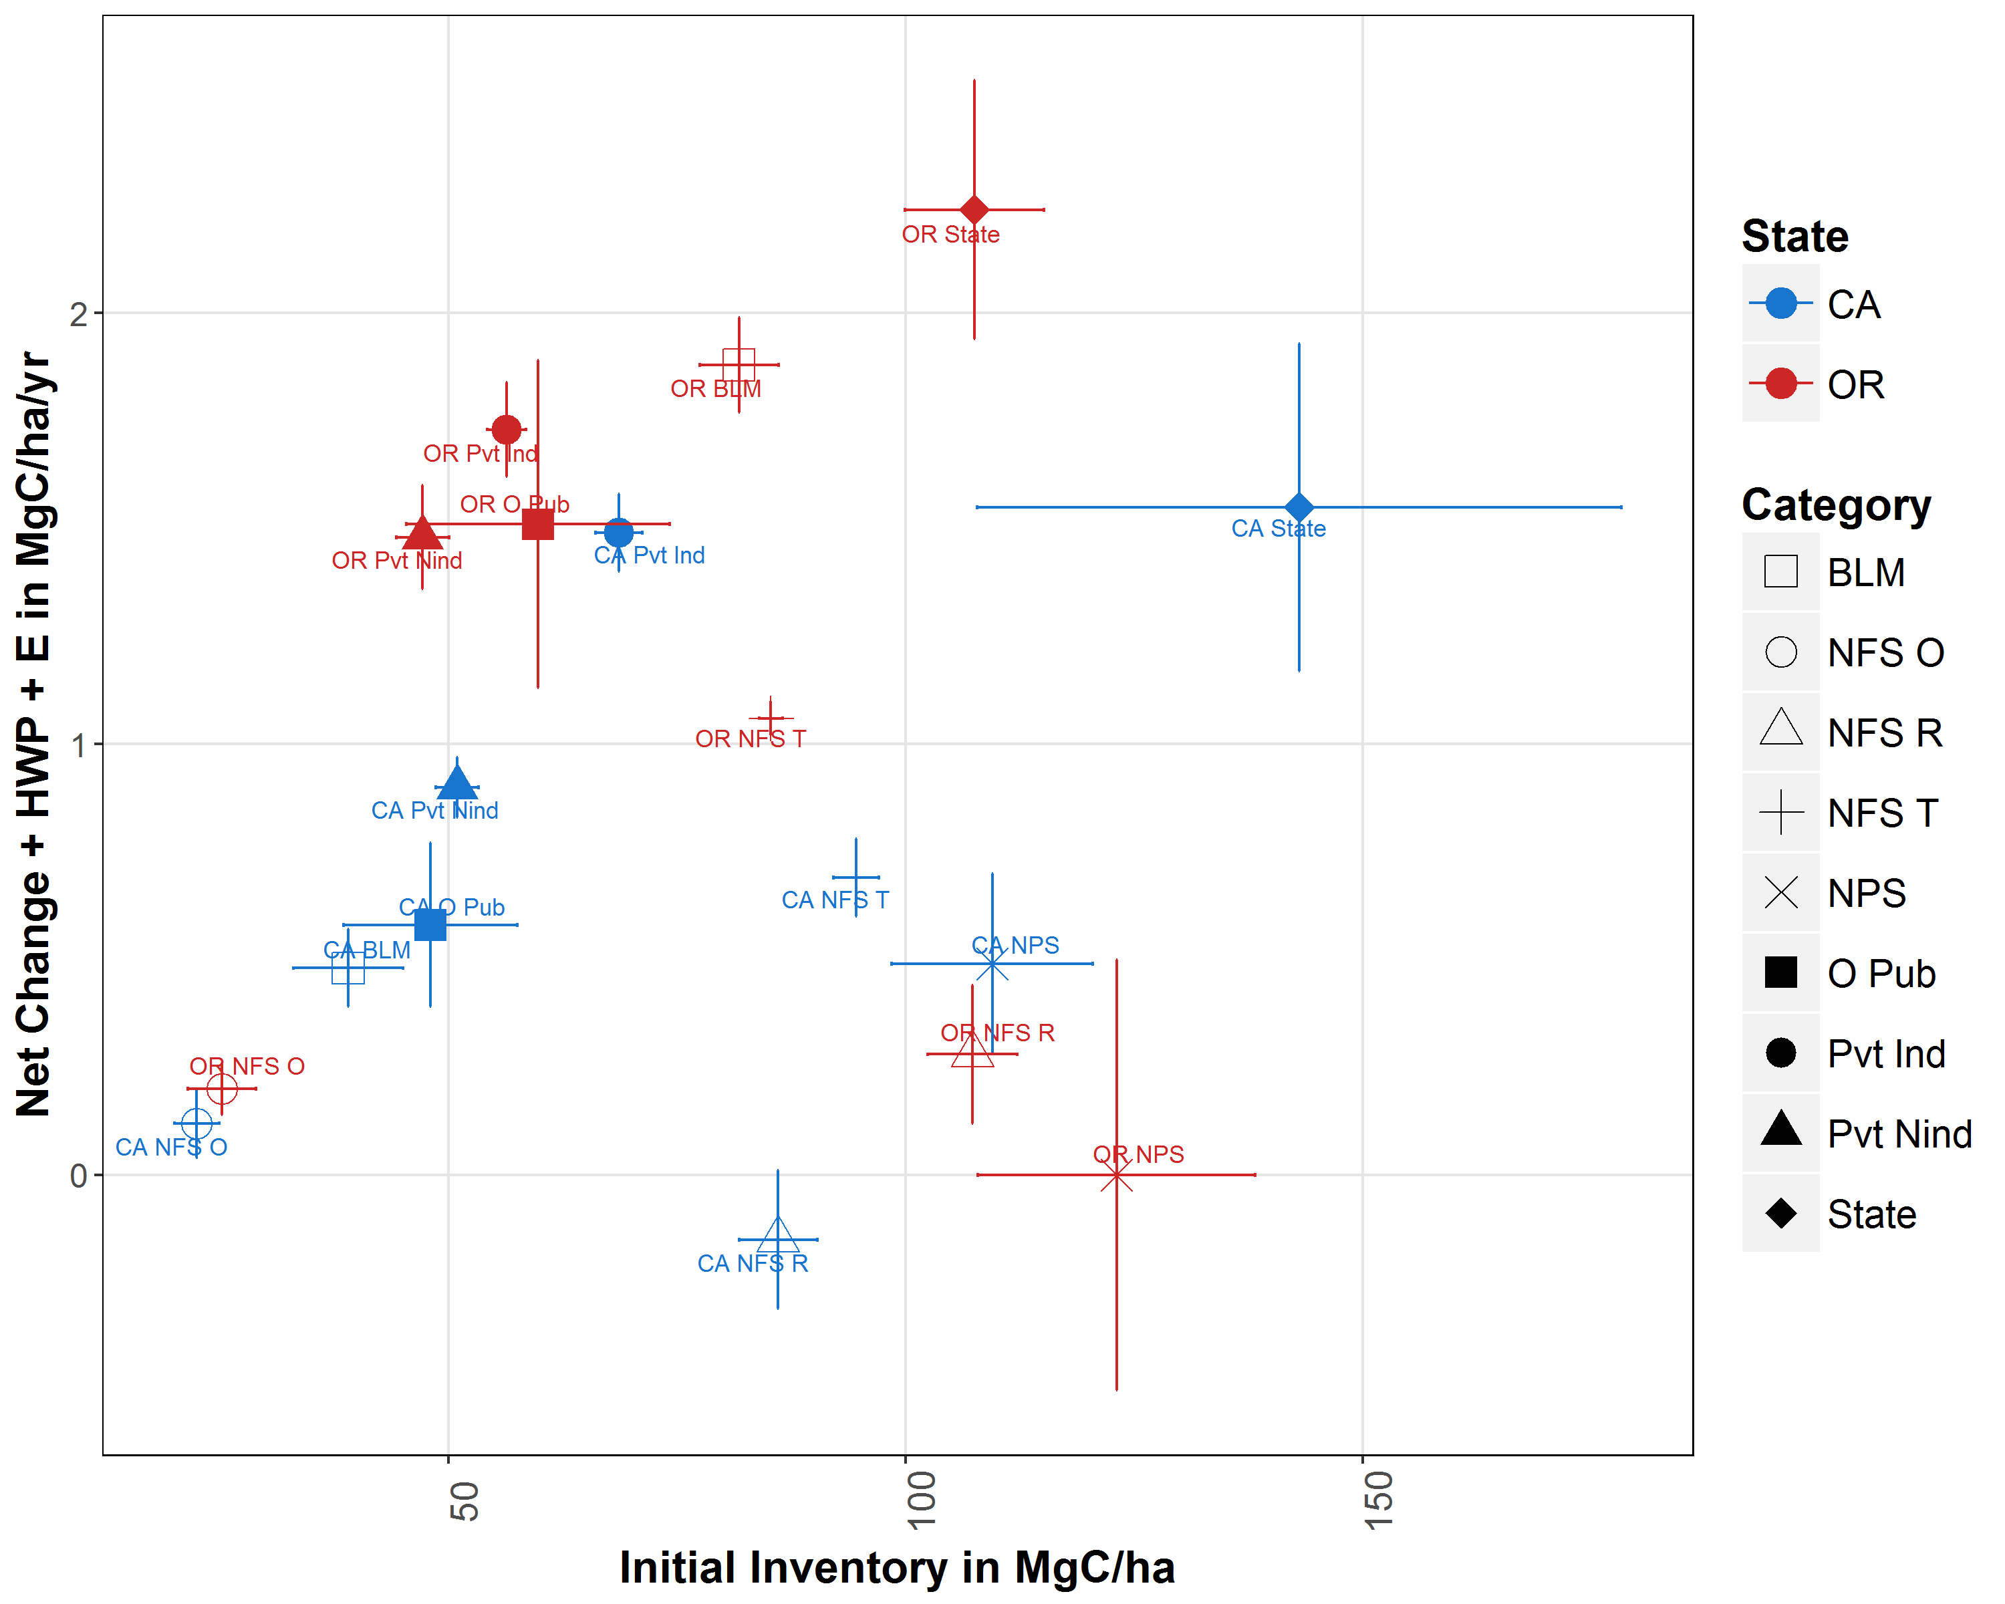
Best Practices: Use 75% of Removals
Notes:
75% utilization – As more and more of the logging slash is chipped and used for bioenergy, rather than being left to decompose or burn, the moderate harvest/moderate inventory strategies look better and better. Very similar to the high harvest/moderate inventory strategy of Oregon’s private industry.
With the exception of CA Wilderness – CA NFS R – every strategy is generating positive carbon sequestration rates.
However, it does appear that NFS Timberlands in both OR and CA could improve by reducing their mortality losses and increasing removals – and more to the NW in this graph. (the red arrow)
In addition, if owners actually could earn a ‘rent’ payment for carbon sequestration or carbon inventories, a shift to higher inventories and higher sequestration rates would appear possible – assuming that BLM and ODF lands are comparable to adjacent private lands. (the blue arrow)
Concluding Points - 3
There seems to be a significant tradeoff between high carbon storage and high carbon sequestration rates at the tree and ownership levels. CA policy conflates the two all the time.
Large differences in fire and non-fire mortality losses on what seem to be similar forest lands suggest that high mortality rates can be managed downwards.
If society is going to be truly serious about increasing overall carbon capture efficiencies, then there are a number of potentially more productive strategies worth exploring.
Thank you and please ask any questions.
Forest management on different ownerships provides insights into forest carbon sequestration
Gross growth tracks site quality but allocation to net change, removals, and mortality is a management choice
Fire and non-fire mortality are manageable
Big trees seem to use much more of carbon sequestration for respiration – lower growth rates
When using harvested products efficiently is a social goal, then privately managed forests generate more climate benefits per hectare than current national forest management – BLM and State lands are interesting public sector alternatives
What is the carbon profile of mortality? Adds dead wood to the existing dead and down inventory that is decomposing every day. Some of the carbon may go into increased SOC in the soil, but forest soils in the west are reasonably high compare to sandy soils common in SE forestry and especially to agricultural soils.
FIA analysts working on this question, but it is more difficult than for live trees, since snags crack off, down wood can roll, move, fracture. And all of this dead and down wood has a much higher probability of high consumption in future wildfires.
In real time, can measure whether dead and down stocks are going up or down or are roughly stable -

Slide 16
Key Points
Significant tradeoff between high carbon storage and high carbon sequestration rates at the tree and ownership levels.
But California forest*climate policy conflates the two metrics all the time – even though there is a tradeoff.
Higher mortality rates on federal lands compared to private lands strongly imply big opportunities for improvements in net climate benefits
Capturing incipient or recent mortality for use as harvested products has financial AND climate benefits

